Slide 1

Deep Semantic Analysis on Restaurant Feedback Using Deep NLP Method

Slide 2
Group members
 | Name | Student Id
1. | Vamsi Krishna Katam | 700756973
2. | Varun Kannamgari | 700741155
3. | Charan Kumar Kamasani | 700754801
4. | Sucharitha Aeluri | 700744961

Slide 3
Role/Responsibilities and Contribution
 | Name | Role and Contribution
1. | Charan Kumar Kamasani | Role: Research Analyst Contribution: Research about various data sources and gathered the relevant data for the project. Contributed in the improving code quality, project architecture and presentation
2. | Varun Kannamgari | Role: Data Engineer (Developer 1) Contribution: Collect and preprocess the dataset, including cleaning and structuring the data. Apply NLP techniques to prepare the data for analysis and modelling Research about various NLP techniques for the problem to tackle for better accuracy of the model.
3. | Vamsi Krishna Katam | Role: Machine Learning Engineer and Project Coordinator (Developer 2) Contribution: Design and try out the various architectures and Implement the sentiment analysis model using Machine Learning and Deep Learning Techniques. Train the test the model, adjusting the parameters to improve accuracy. Evaluate the model’s performance using standard metrics
4. | Sucharitha Aeluri | Role: Documentation and Reporting Contribution: Document the project methodology, including data preparation, model building and evaluation process. Prepare the final project report and presentation and summarizes findings and insights.

Slide 4
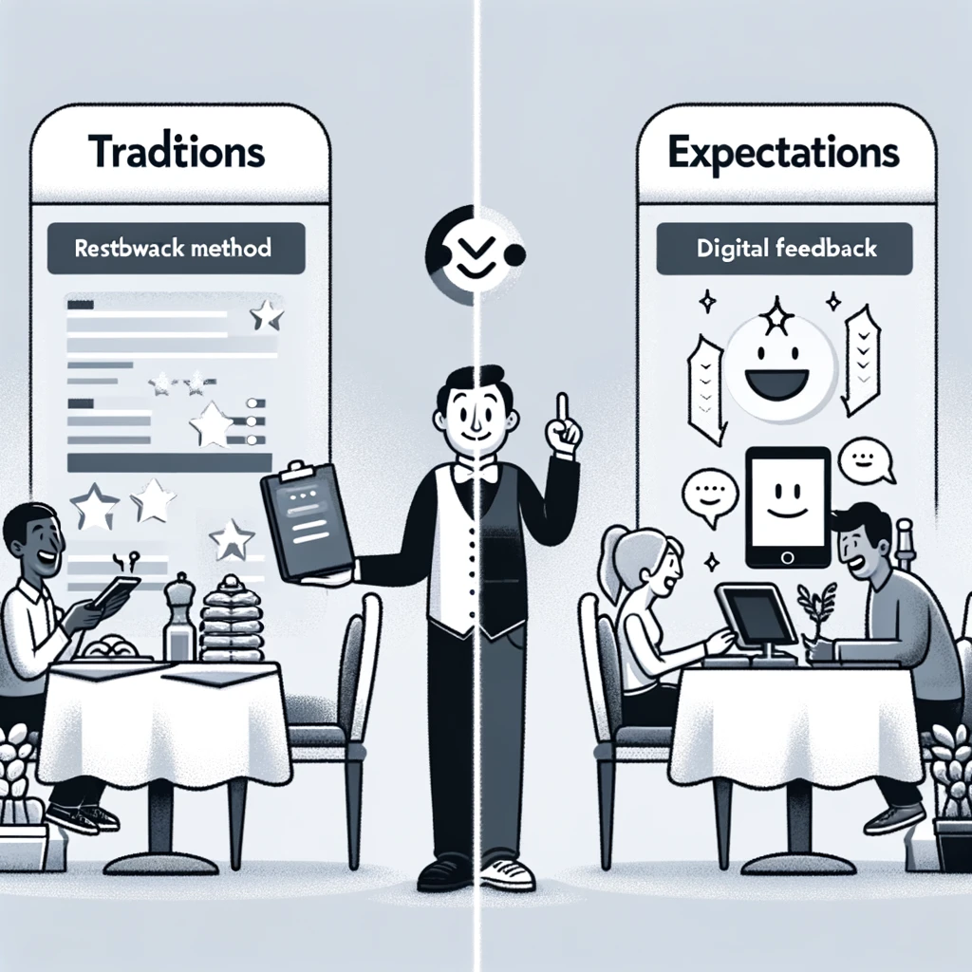
Motivation
The Critical Role of Customer Feedback in the Restaurant Industry
Enhancing Customer Experiences Through Feedback:
Importance of Feedback: Direct reflection of customer experiences and expectations; drives improvements and customer satisfaction.
Challenges with Current Methods:
Manual reviews and basic analytics fail to capture the depth and breadth of feedback.
Difficulty in processing high volumes and diverse data from multiple online platforms.

Slide 5
Objective
Leveraging Advanced NLP for Enhanced Restaurant Feedback Analysis
Goal: Utilize cutting-edge NLP techniques, including Deep Learning Algorithms such as LSTM models, to conduct a deep semantic analysis of restaurant feedback.
Purpose: Extract actionable insights to boost customer satisfaction and competitive edge for restaurants.
Workflow:
Data Collection: Gather diverse feedback from multiple online platforms to ensure a comprehensive dataset.
Preprocessing: Implement rigorous data cleaning for consistency and noise reduction.
Model Development and Evaluation: Develop sentiment analysis and topic modeling tools, evaluated via accuracy and F1 scores.
Visualization: Create intuitive visualizations to clearly communicate findings to stakeholders.
Impact: Enhance the decision-making process in the restaurant industry and advance the application of NLP in business analytics.

Slide 6
Transforming Feedback Analysis with Advanced NLP Techniques:
Leveraging Deep Learning for Deeper Insights
Advanced NLP Techniques:
Data Cleaning with NLTK:
Tokenization and stop words Removal: Streamline text using NLTK for better analysis.
Normalization: Apply stemming and lemmatization to unify word variations.
Feature Extraction:
Word Embeddings: Utilize Word2Vec or GloVe to convert text into contextual vectors that serve as input for models.
Machine Learning Techniques:
Traditional Algorithms: Brief trials with Naive Bayes, Logistic Regression, and SVM highlighted initial insights.
Deep Learning Progress: Transition to LSTM for capturing temporal dynamics and FFNN for pattern recognition in text.
Benefits:
Uncover hidden patterns, identify trends, and better predict customer behavior.
Enable restaurants to tailor services proactively and innovate offerings, leading to sustained business growth.

Slide 7
Related Work
Advancements in NLP and Sentiment Analysis
Sentiment Analysis Evolution:
Transition from lexicon-based approaches with limited context sensitivity to machine learning methods that enhance accuracy and contextual understanding.
Adoption of SVM and Naive Bayes for pattern learning in sentiment classification.
Deep Learning Breakthroughs:
Integration of CNNs for capturing text features and RNNs for sequential data processing.
Implementation of attention mechanisms and Transformers, significantly boosting performance in complex NLP tasks.
Comprehensive NLP Techniques:
Broad spectrum of text analysis tools from Named Entity Recognition (NER) and Part-of-Speech (POS) tagging to advanced semantic analysis and topic modeling.
Techniques like LDA and LSA for uncovering underlying themes in text, enhancing clustering and summarization efforts.

Slide 8
Problem Statement
Addressing the Challenges in Restaurant Feedback Analysis
Inadequate Analysis Methods:
Traditional feedback analysis methods like manual reviews and basic analytics often fail to capture the full spectrum of customer sentiment, missing nuances and context.
Volume and Variety:
The increasing volume and variety of feedback across multiple online platforms present significant challenges in data handling and analysis, making it difficult to process and synthesize large amounts of unstructured text effectively.
Need for Advanced Solutions:
There is a critical need for more sophisticated analytical tools that can handle complex data, uncover deep insights, and provide actionable recommendations to improve customer satisfaction and competitive positioning in the restaurant industry.

Slide 9
Proposed Solution
Advanced Architecture for Sentiment Analysis
Data Collection and Integration:
Automated systems to collect feedback from multiple sources (review sites, social media, direct customer feedback).
Integration with existing databases to enrich analysis (e.g., customer profiles, historical data).
Preprocessing Pipeline:
Tokenization, Normalization, and stop words Removal: Standardize text data to ensure uniform input to machine learning models.
Embedding Layer: Use of Word2Vec or GloVe to convert text into meaningful vector representations that capture semantic and syntactic nuances.
Core Analysis Models:
LSTM Layer: Captures temporal dependencies in text data, ideal for understanding the context and flow of sentiments in customer feedback.
FFNN Layer: Processes output from LSTM to classify sentiments and identify key themes or aspects.
Attention Mechanisms: Employed to weigh the importance of different words in the feedback, focusing the analysis on the most impactful terms.
Output and Visualization:
Sentiment scores and categorization (positive, negative).
Dynamic dashboards displaying real-time sentiment trends, aspect-based analysis, and actionable insights.

Slide 10
Architecture
Data Collection
Data cleaning
Feature Engineering
Model Training
Evaluation
Feedback
cloud
spreadsheets

Slide 11
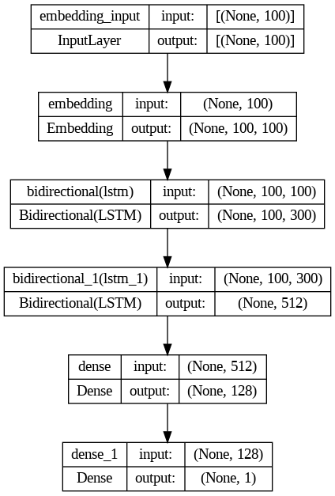
Model Architecture

Slide 12
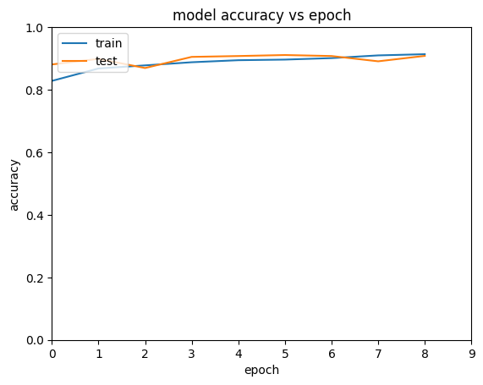
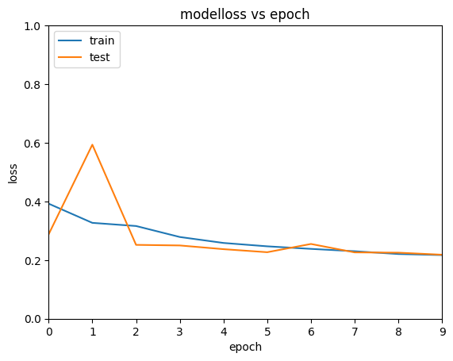
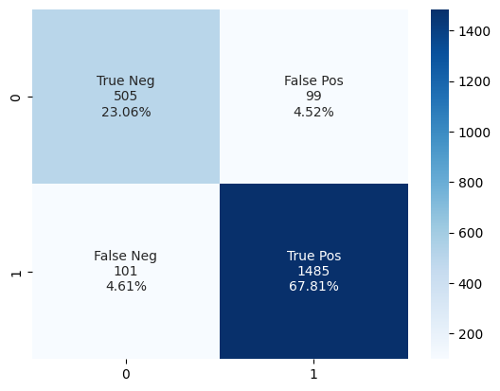
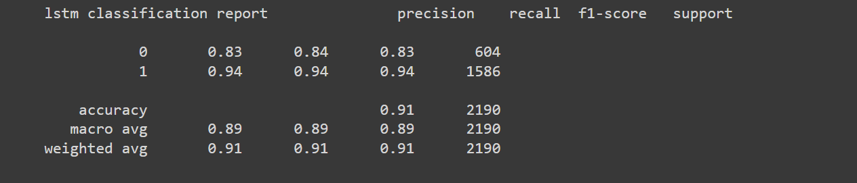
Model Evaluation

Slide 13
Results

Slide 14
References
Goldberg, Y. (2016). A Primer on Neural Network Models for Natural Language Processing. Journal of Artificial Intelligence Research, 57, 345-420.
Relevance: Provides a comprehensive overview of neural network applications in NLP, foundational for understanding modern NLP techniques.
Maas, A. L., et al. (2011). Learning Word Vectors for Sentiment Analysis. Proceedings of the 49th Annual Meeting of the Association for Computational Linguistics: Human Language Technologies, 142–150.
Relevance: Discusses the development of word vectors for sentiment analysis, directly applicable to analyzing restaurant reviews.
Pennington, J., Socher, R., & Manning, C. D. (2014). GloVe: Global Vectors for Word Representation. Proceedings of the 2014 Conference on Empirical Methods in Natural Language Processing (EMNLP), 1532–1543.
Relevance: Explores GloVe, a method for efficiently learning word vectors, which is crucial for the feature engineering phase of sentiment analysis.
4. https://www.geeksforgeeks.org/natural-language-processing-nlp-pipeline/
5. https://www.analyticsvidhya.com/blog/2021/10/a-comprehensive-guide-on-deep-learning-optimizers/
6. https://medium.com/@dtuk81/confusion-matrix-visualization-fc31e3f30fea
7. https://machinelearningmastery.com/predict-sentiment-movie-reviews-using-deep-learning/
8. https://www.analyticsvidhya.com/blog/2022/01/sentiment-analysis-with-lstm/
9. https://colah.github.io/posts/2015-08-Understanding-LSTMs/

